Slide 1
Efficient protocols for set membership and range proofs
Jan Camenisch, Rafik Chaabouni, Abhi Shelat: Efficient Protocols for Set Membership and Range Proofs. ASIACRYPT 2008: 234-252.

Slide 2
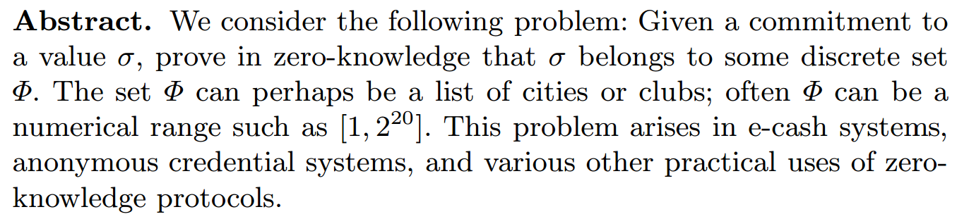
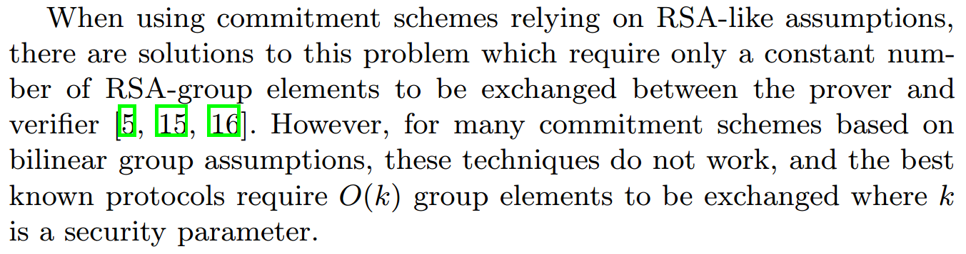
Abstract
在不泄露具体值的情况下，证明承诺值的范围
1. 现有基于RSA猜想的方案，交互元素数量为固定常数，即可实现范围证明。
2. 此类构造方式不适用于基于双线性群猜想下构造范围证明。

Slide 3
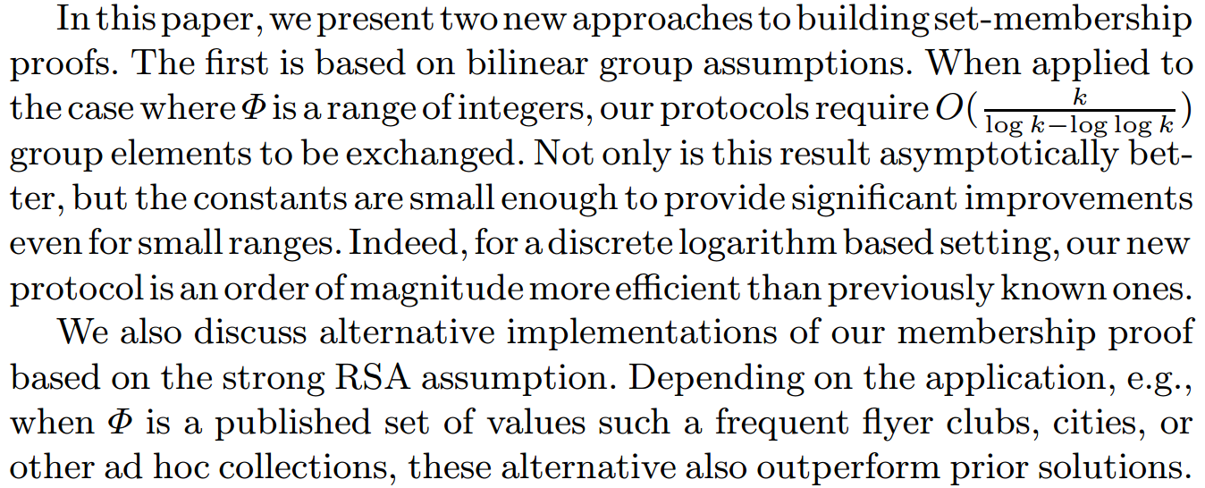
Abstract
渐近性更好、常数足够小 (即使范围较小)
Boneh-Boyen签名 → q-SDH猜想 (q-Strong Diffie-Hellman assumption)
可选实现—其他签名方案、累加器 → Strong RSA assumpiton

Slide 4
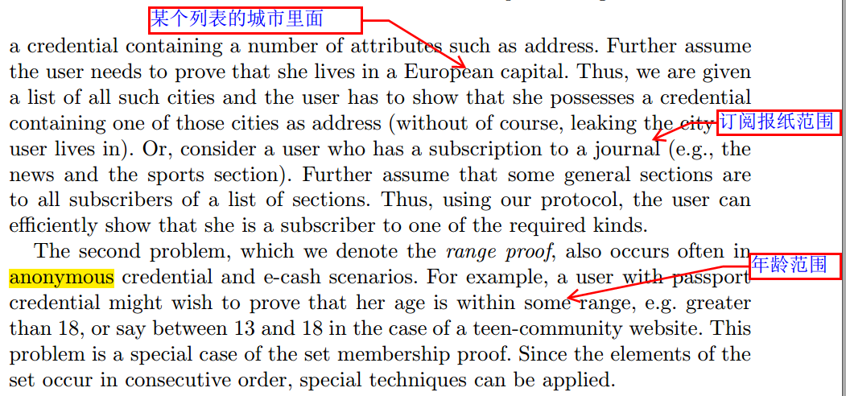
Introduction

Slide 5
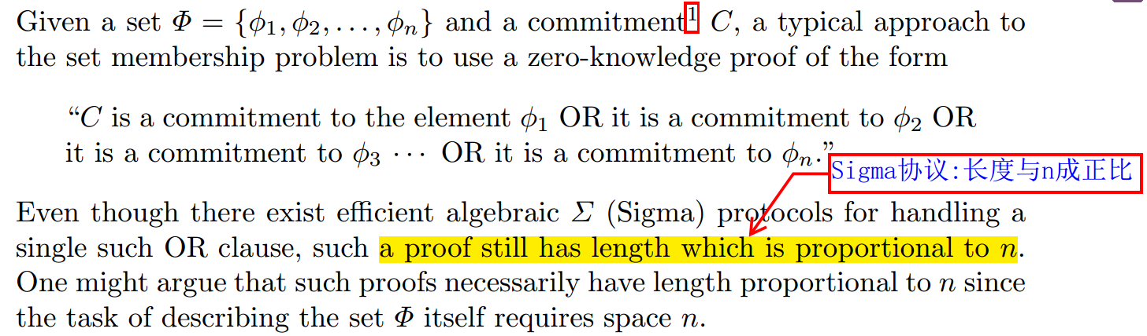
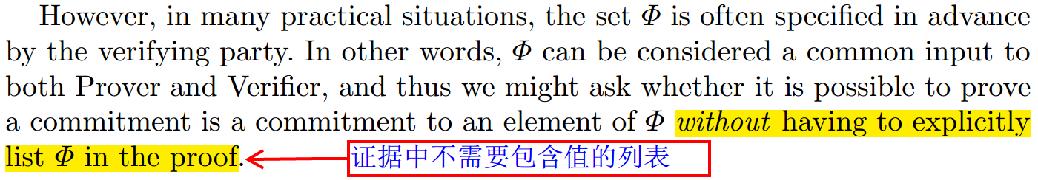
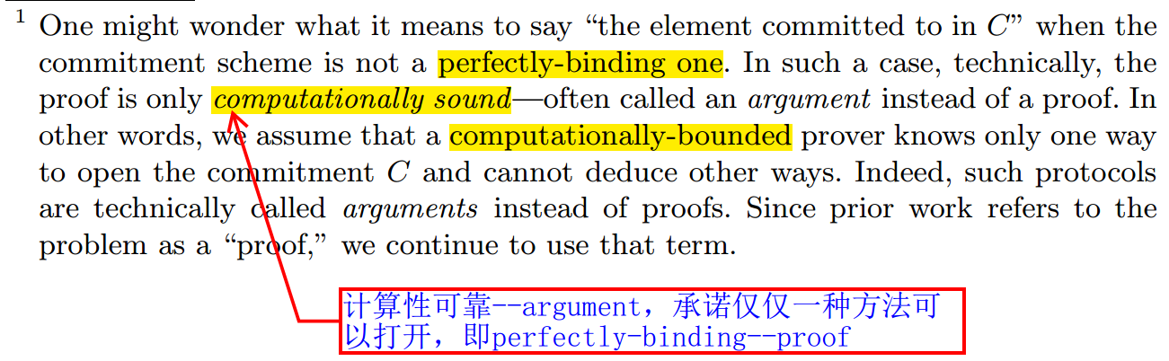
Introduction

Slide 6
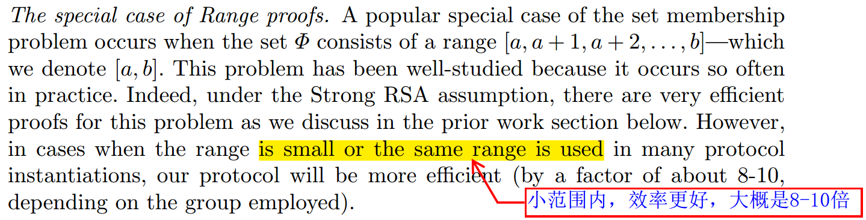
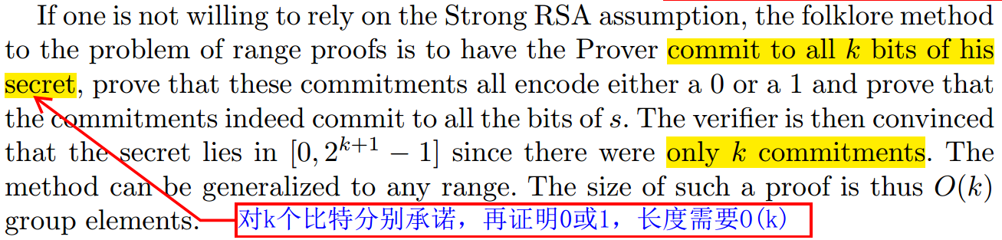
Introduction

Slide 7
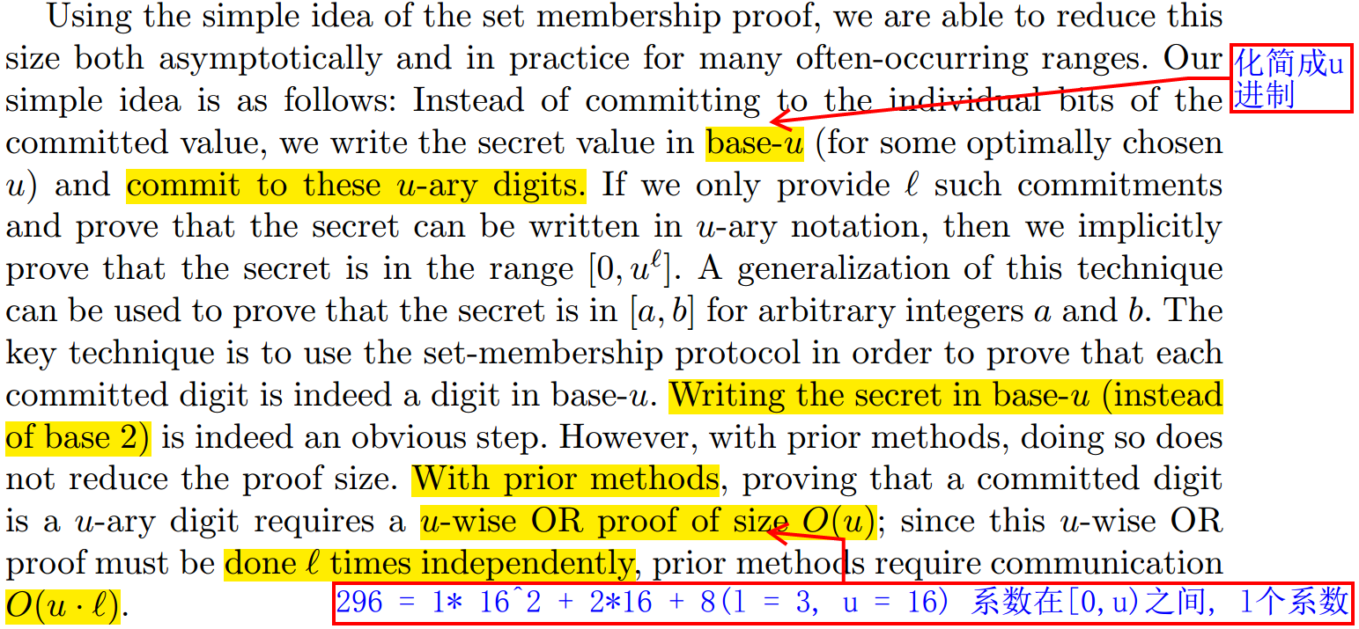
Introduction

Slide 8
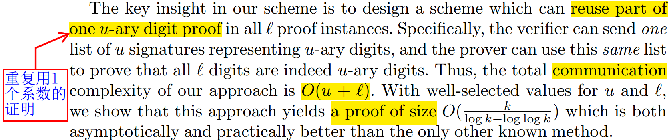
Introduction

Slide 9
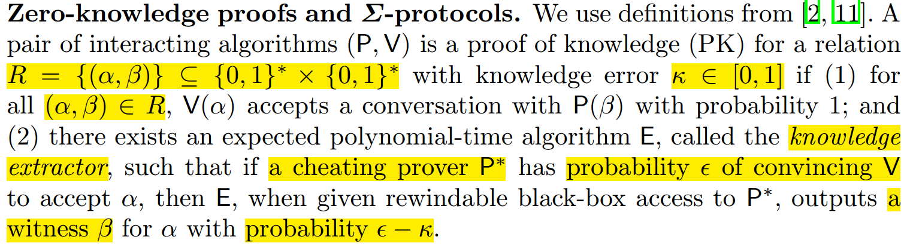
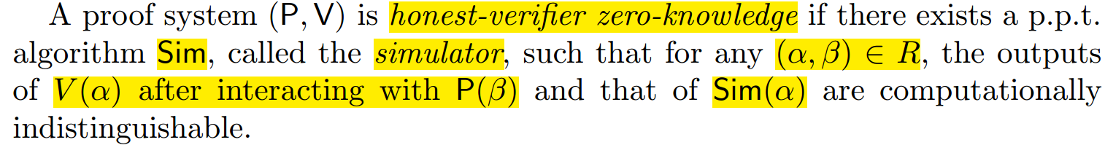
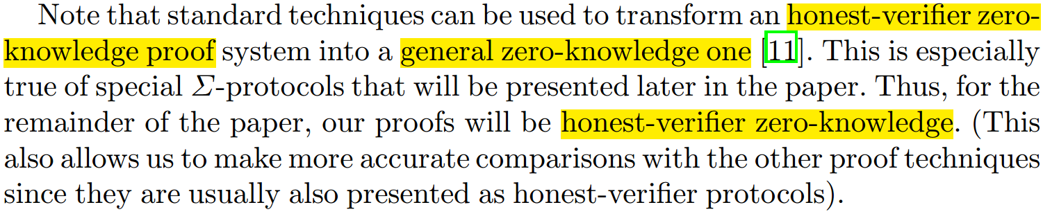
Definition

Slide 10
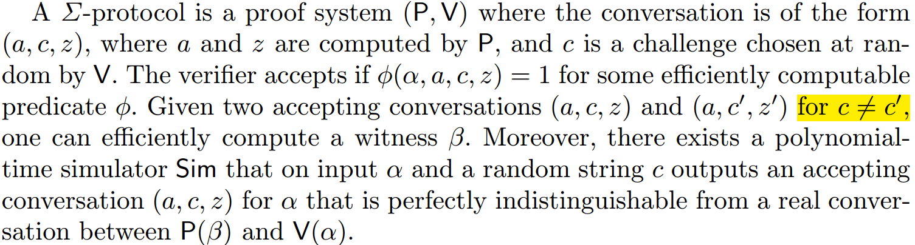
Definition

Slide 11
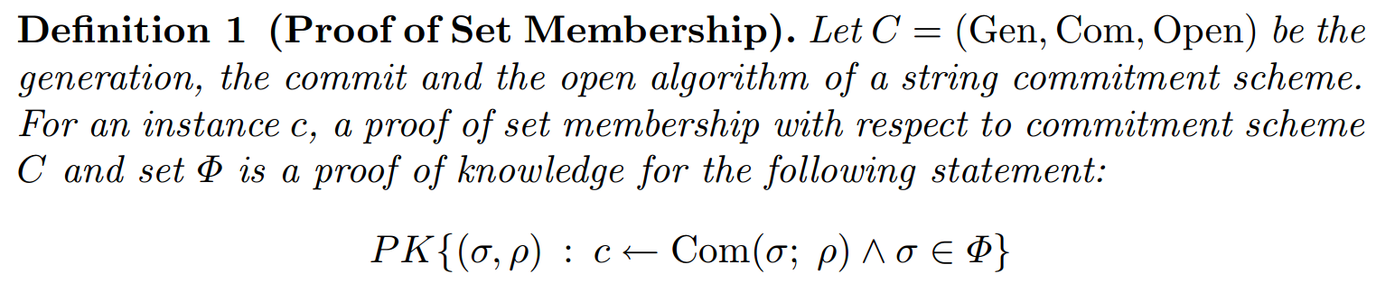
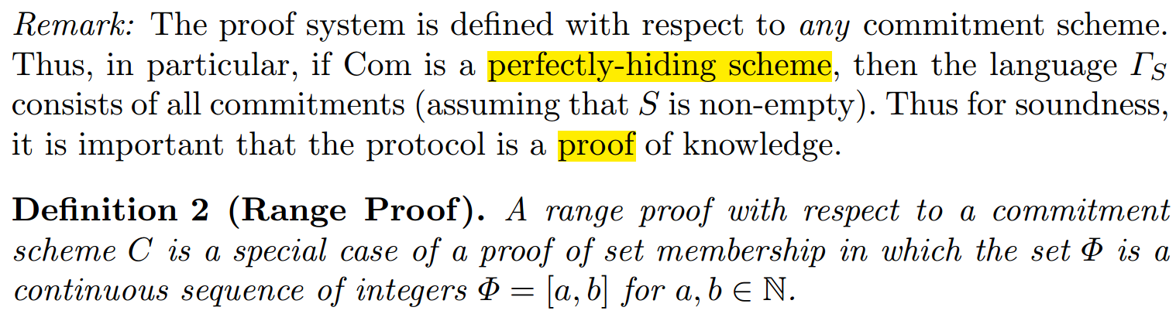
Definition

Slide 12
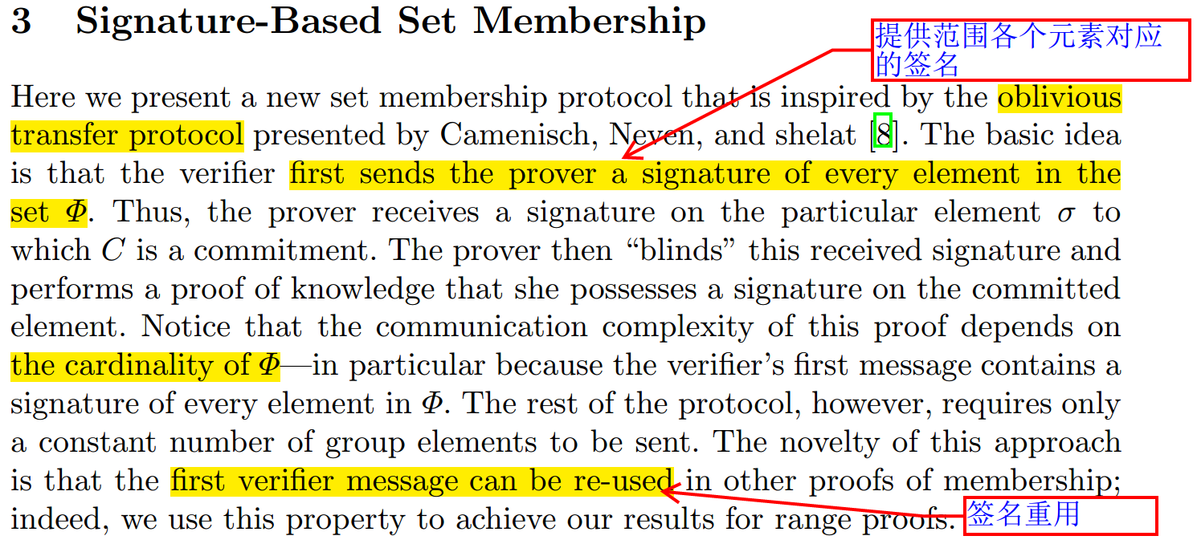
Definition

Slide 13
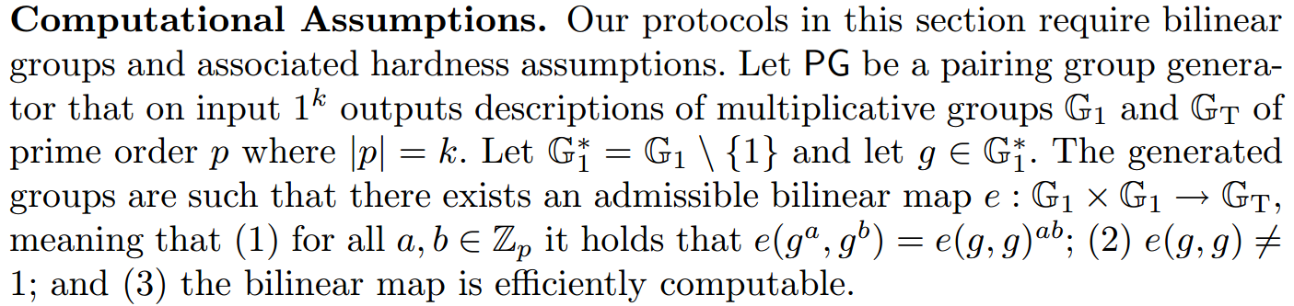
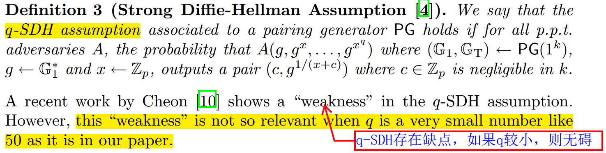
Definition

Slide 14
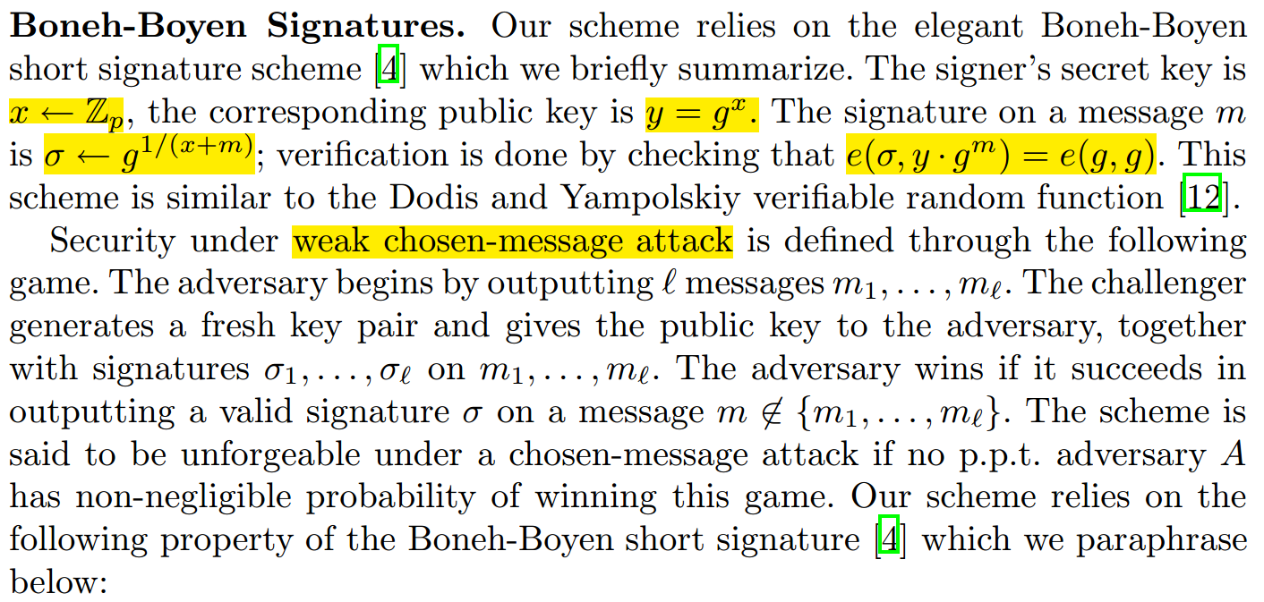
Definition

Slide 15
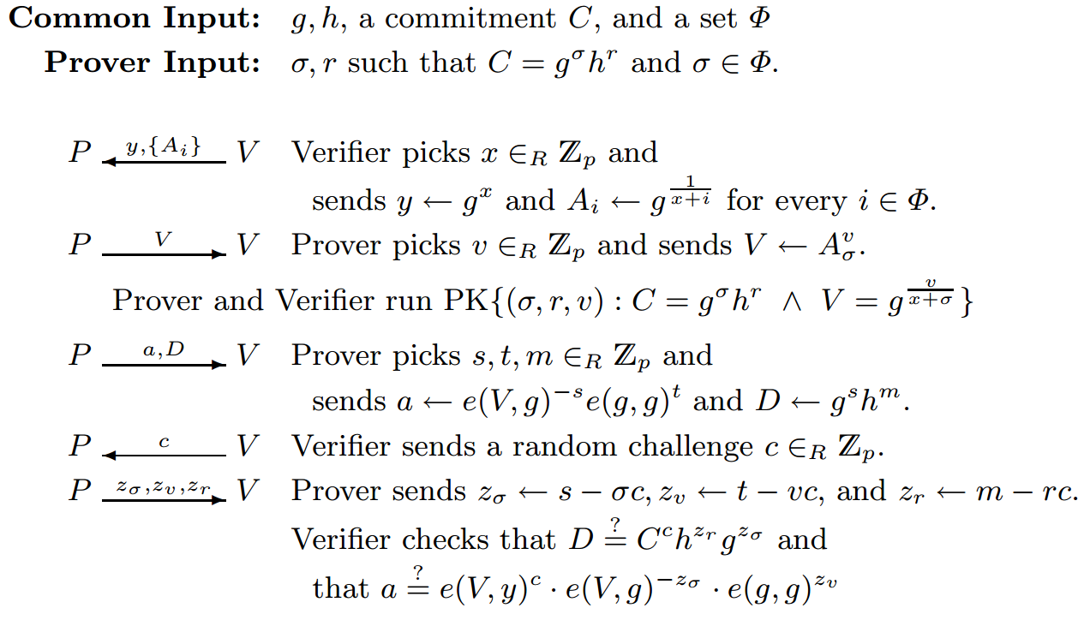
Set membership protocol for set Φ

Slide 17
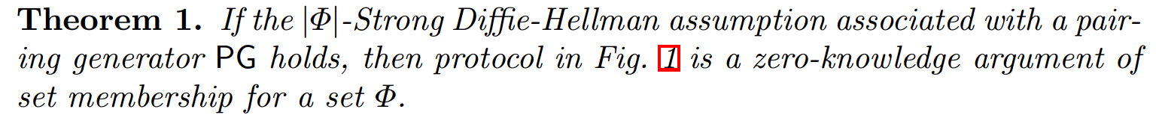
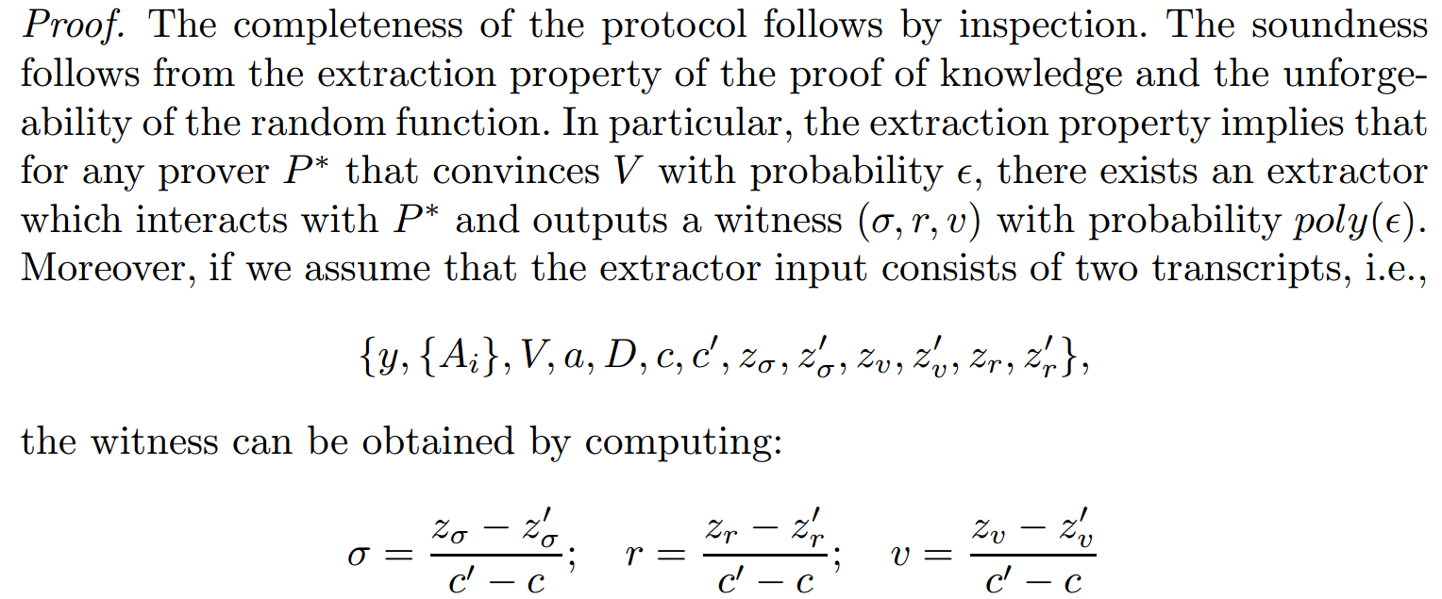
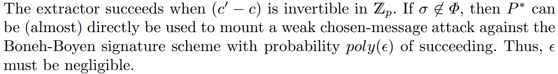
Set membership protocol for set Φ

Slide 18
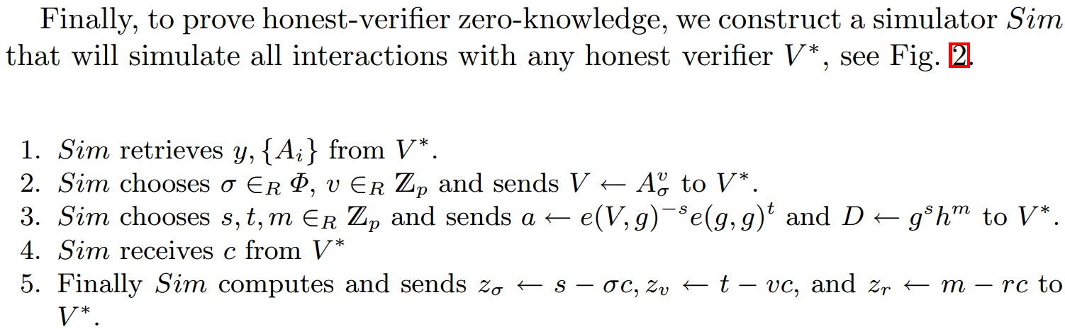
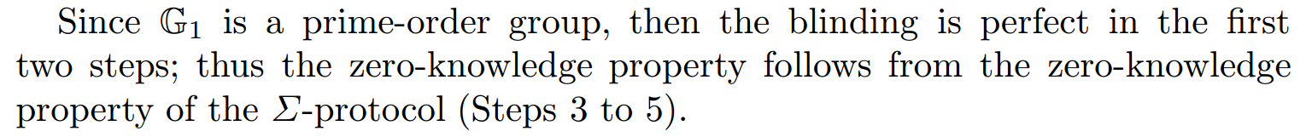
Set membership protocol for set Φ
事先确定承诺值，再利用随机预言机配置挑战

Slide 19
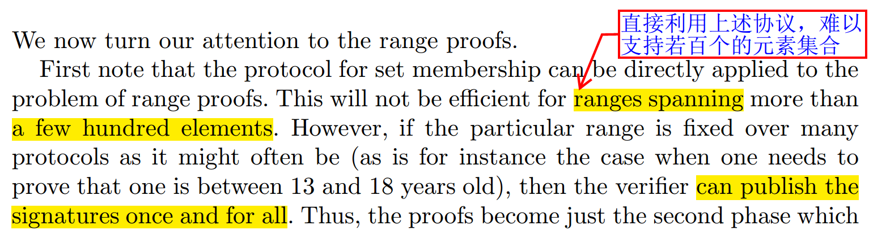
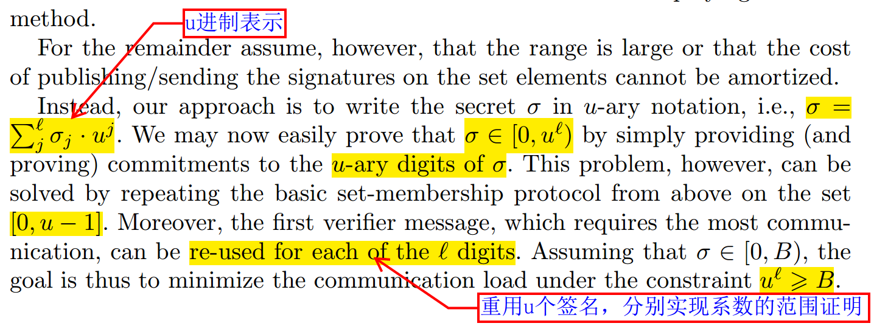
Range Proofs

Slide 20
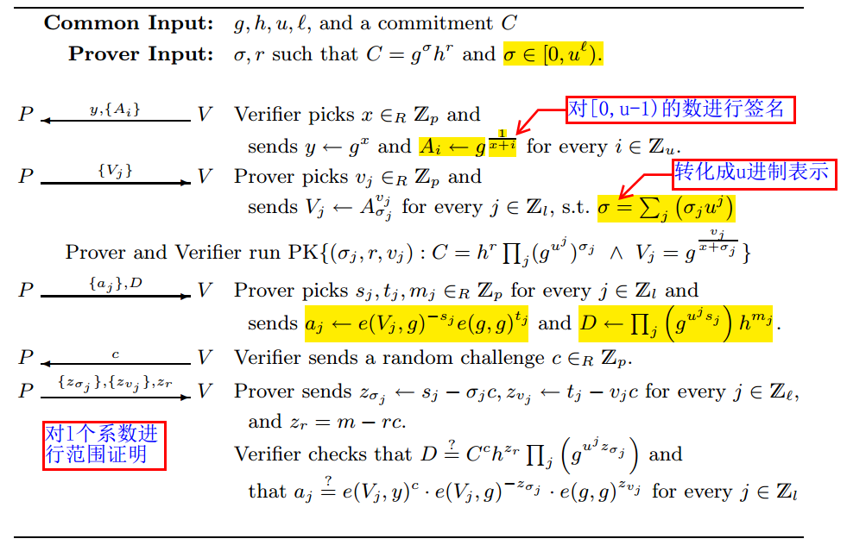
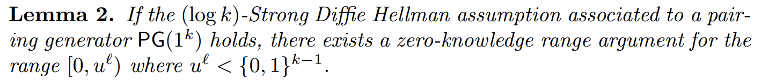
Range Proofs

Slide 21
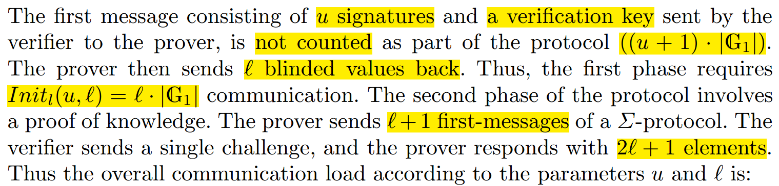
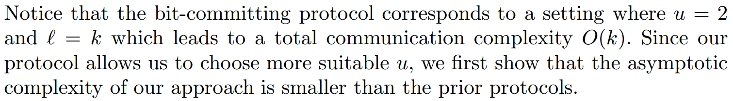
Communication Complexity

Slide 22
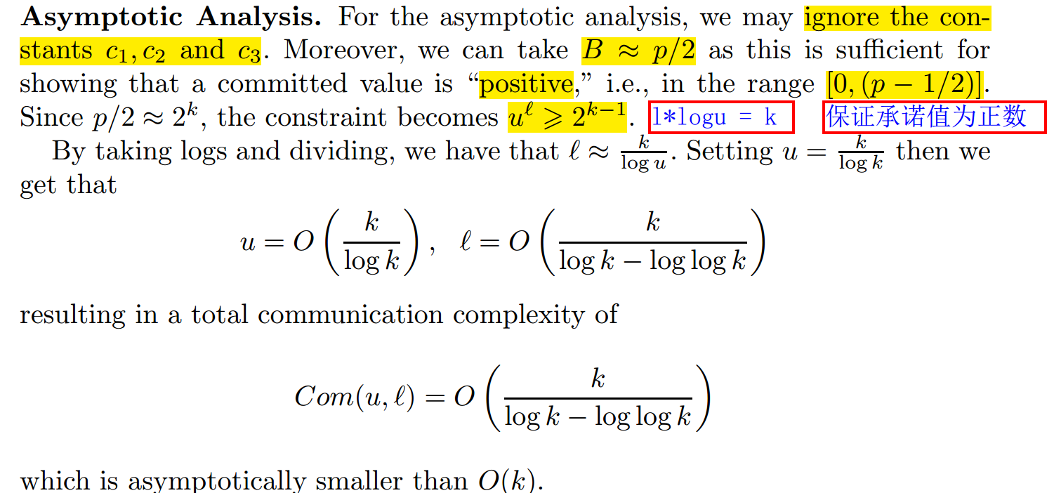
Communication Complexity
p为k比特长度的素数

Slide 23
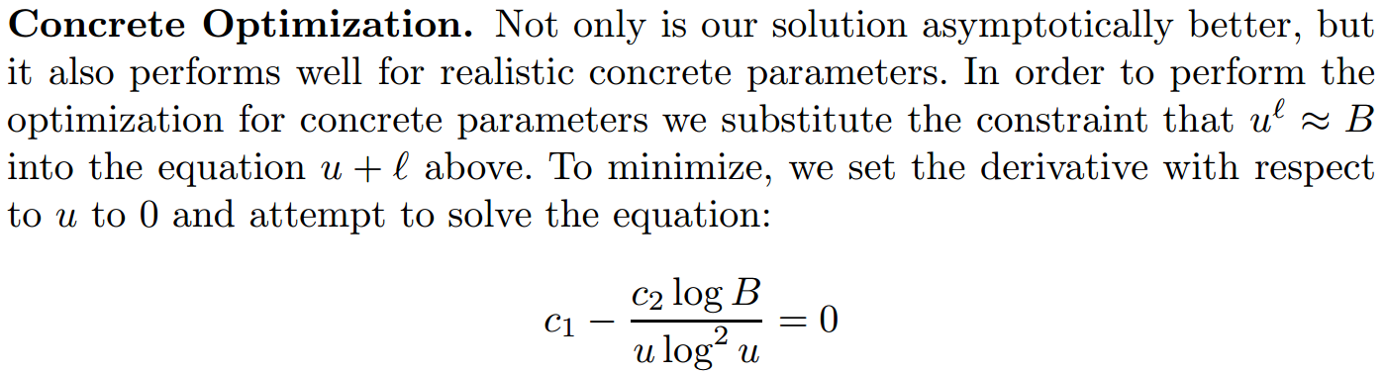
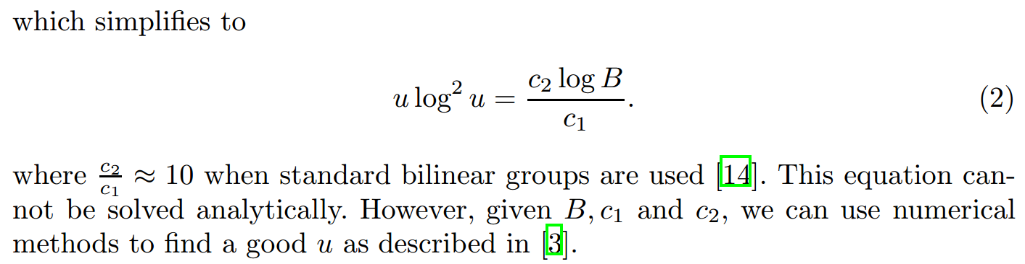
Communication Complexity
对u^{l} = B（即l = logB/logu）中关于u进行求导

Slide 24
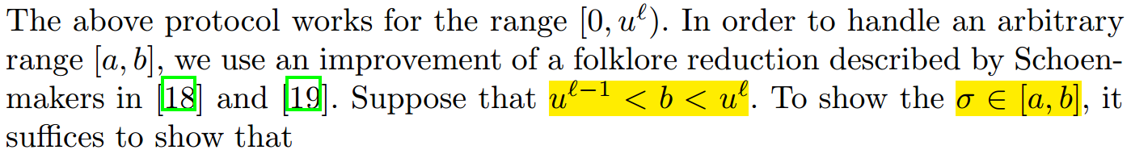
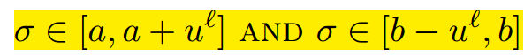
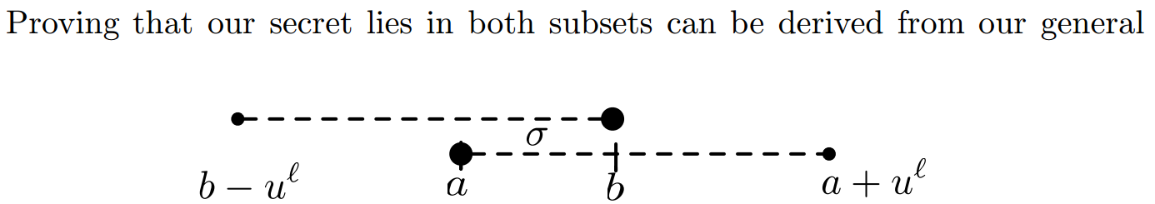
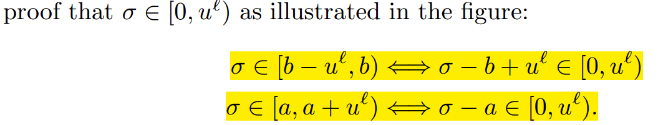
Handling Arbitrary Ranges [a, b]

Slide 25
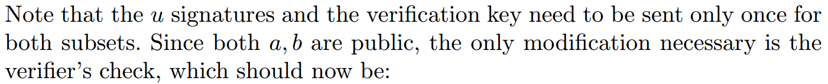
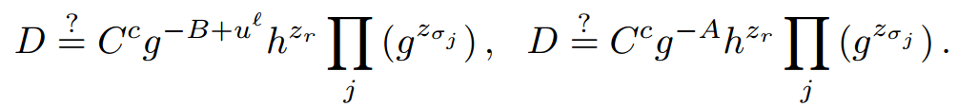
Handling Arbitrary Ranges [a, b]

Slide 26
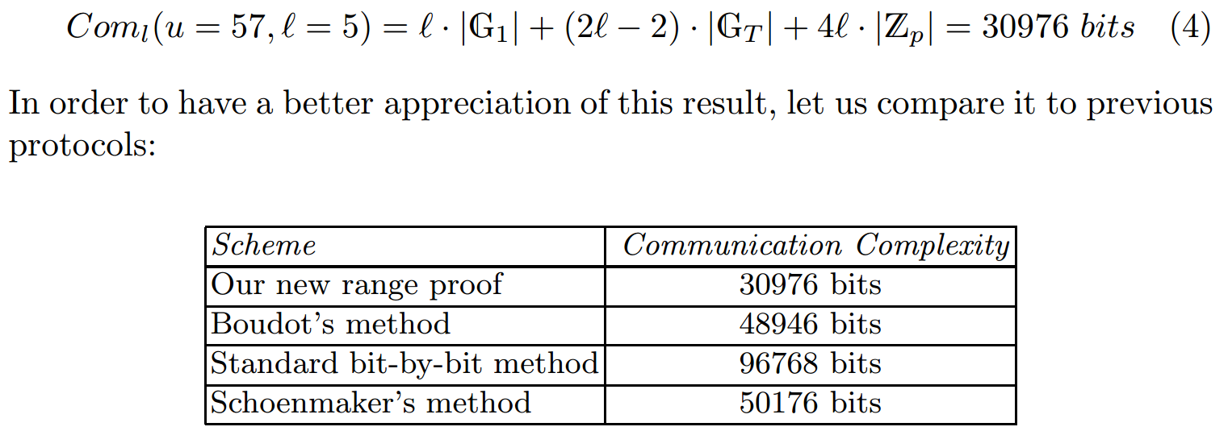
Concrete Example and Discussion

Slide 27
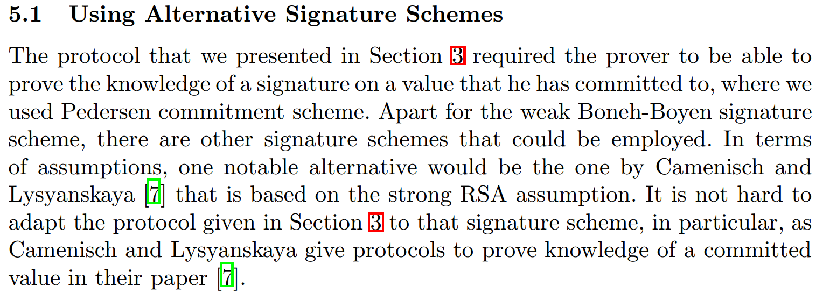
Alternative Set Membership Proofs

Slide 28
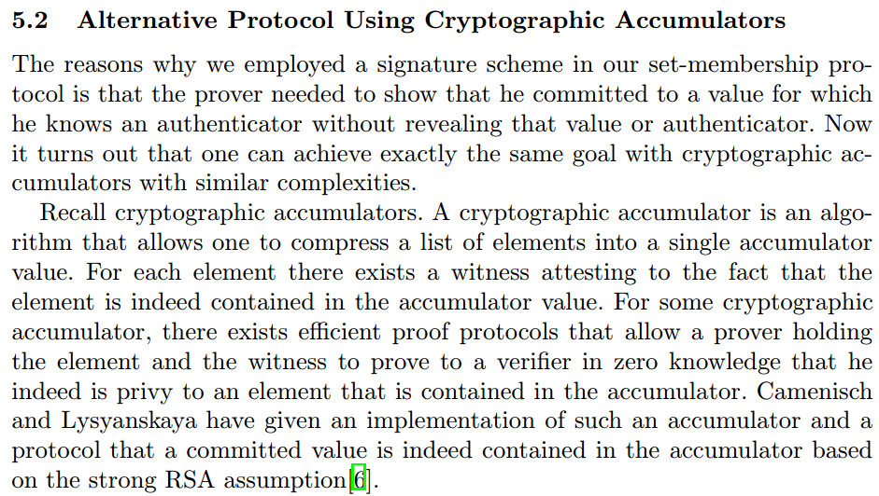
Alternative Set Membership Proofs

Slide 29
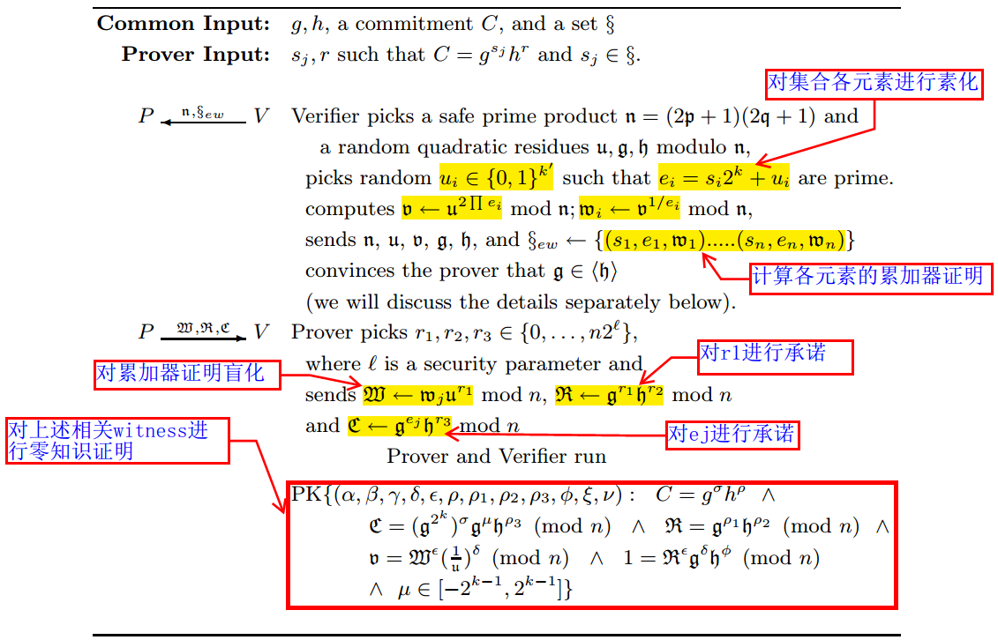
Accumulator Based Membership Proof

Slide 30
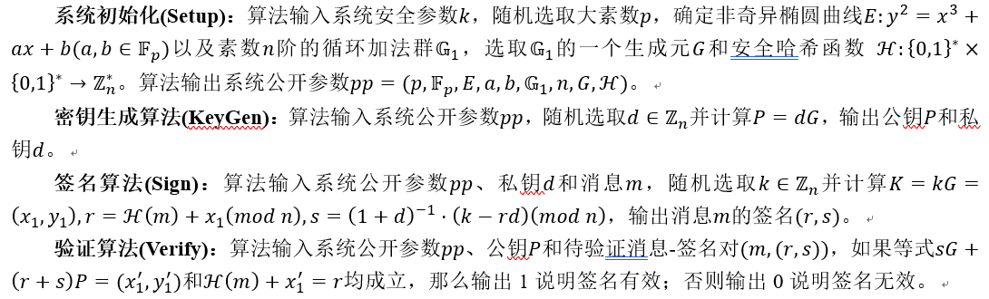
SM2 Membership Proof

Slide 31
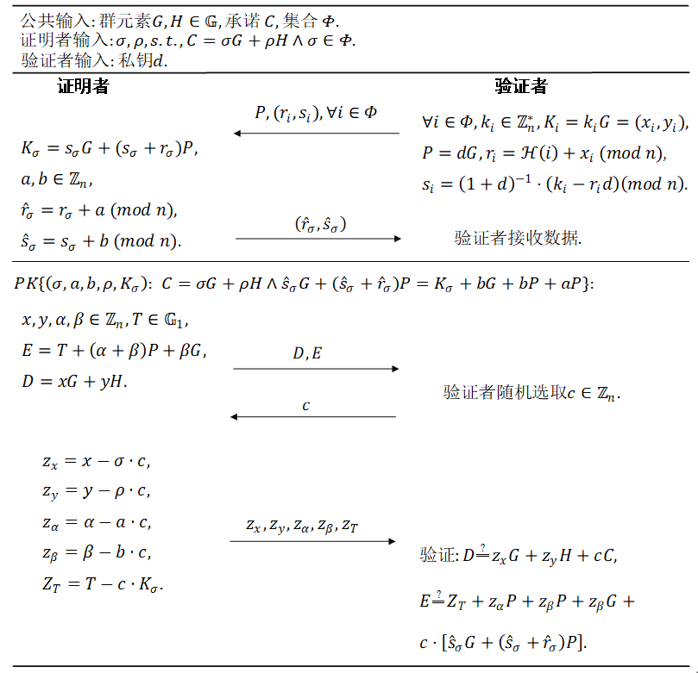
SM2 Membership Proof

Slide 32
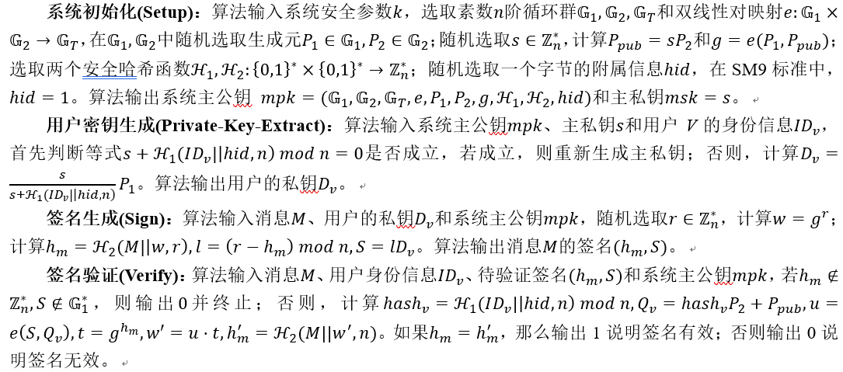
SM9 Membership Proof

Slide 33
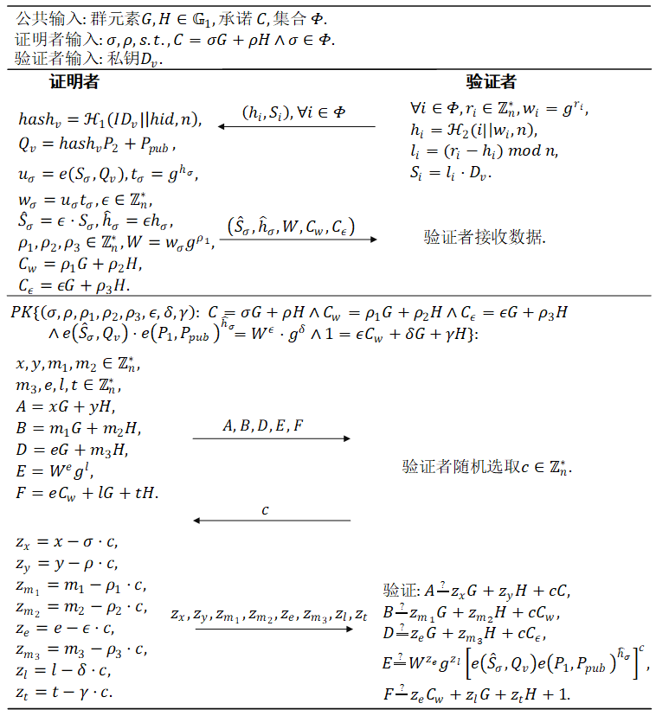
SM9 Membership Proof

